Slide 1
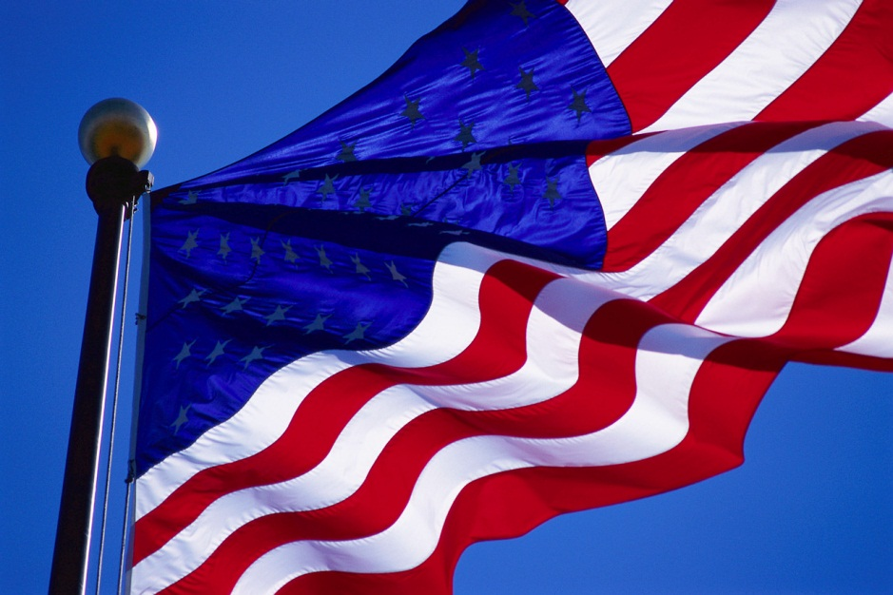
Unleash American Business

Slide 2
Unleash American Business
When you think of America
Land of Opportunity
Freedom to innovate
Entrepreneurial spirit

Slide 3
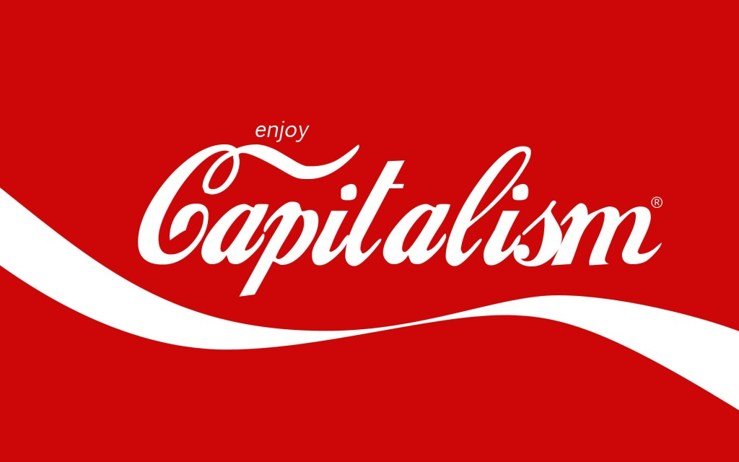
Unleash American Business
Capitalism works when
Level playing field
Regulation is reasonable
Room to maneuver

Slide 4
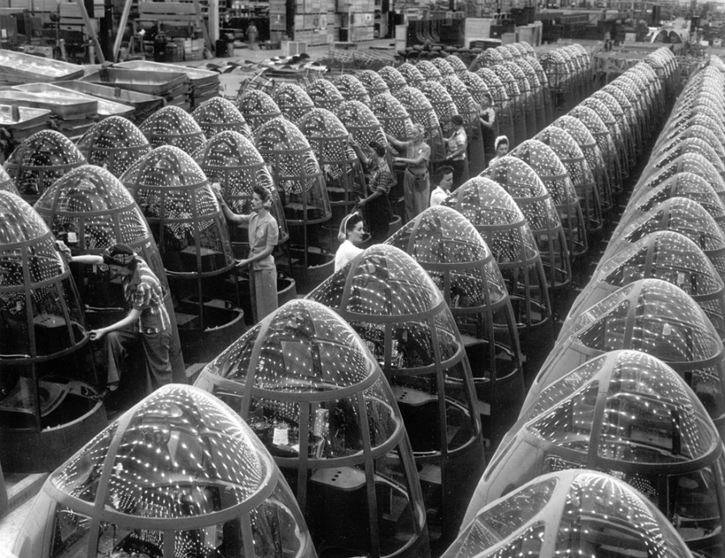
Unleash American Business
Health Care and American Business
WW II wage controls
When health care was simple and cheap
Benefits now wagging the dog

Slide 5
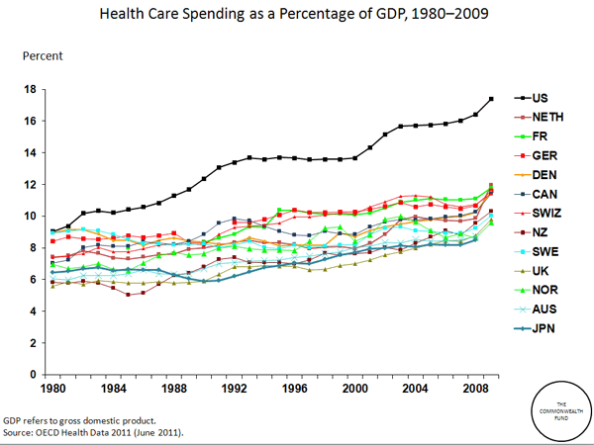
Unleash American Business
Health Care costs out of control
18% of GDP and rising
Distortion of business expense
Poor Quality and Access

Slide 6
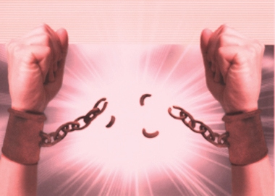
Unleash American Business
Two problems, One solution
Decouple health care finance from business
Promote Medicare for All
Get back to work

Slide 7
Unleash American Business
Why Decouple and Promote?
The business of business is business
All other nations pick up the cost
As long as there is a hole money flows like water
Healthy employees are productive

Slide 8
Unleash American Business
How would Medicare for All work
Redirect current spending – no new funds needed
All medically necessary from licensed providers
What about Death Panels? – Same as current

Slide 9
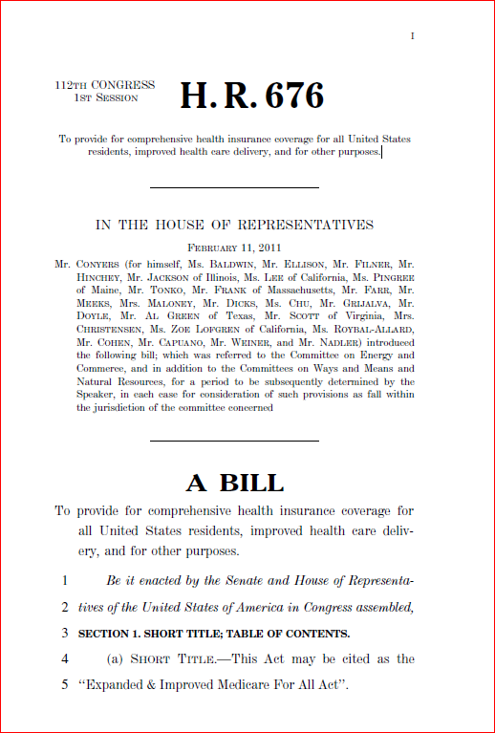
Unleash American Business
What you can do today
Support HR 676
Partner with PNHP
Get back to work

